Slide 1



HOSPITAL DATABASES
FOCUS ON DOCTOR
Shekina Kadiongo 916110105
Leroy Maswaure 1710240005
Kimseng Houy 1809170001

Slide 2
Focus
ER
UML
Relational Schema
Program

Slide 3
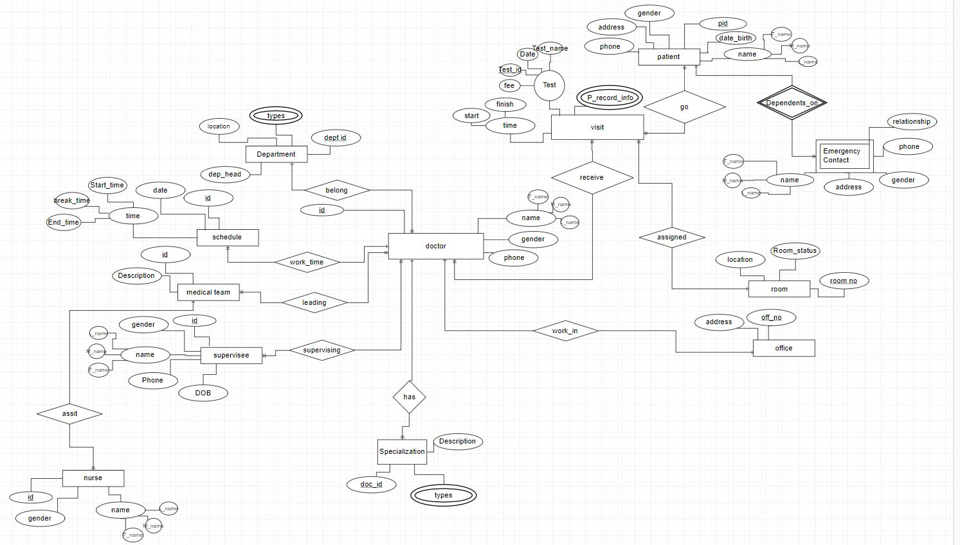
ER

Slide 4
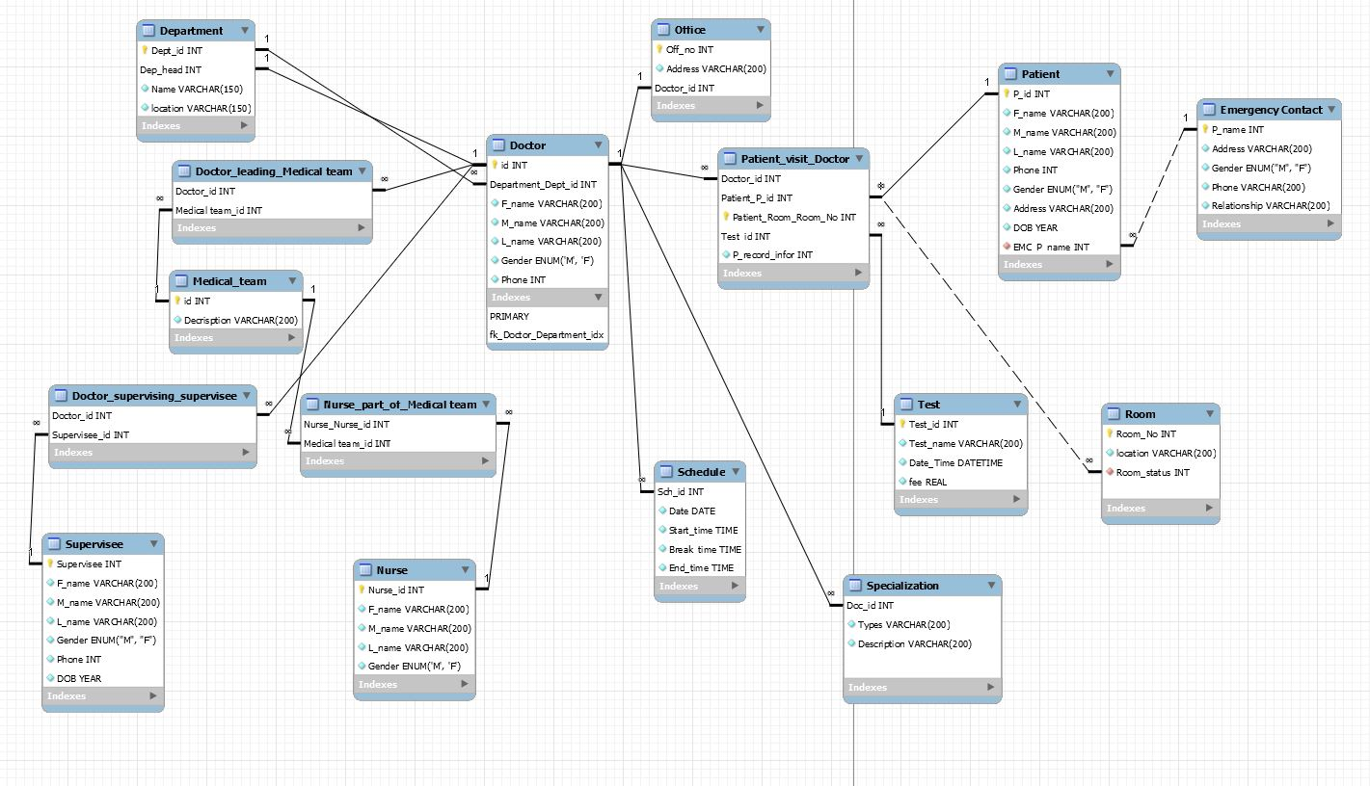
UML

Slide 5
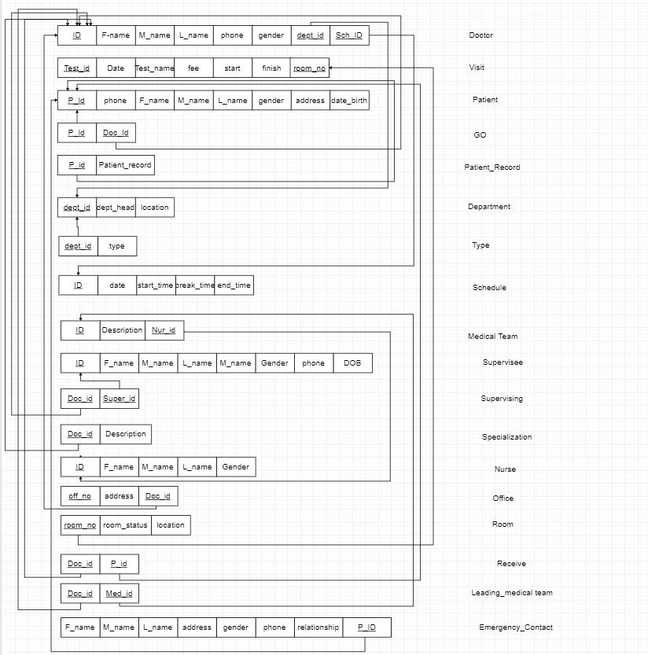
Relational Schema

Slide 6
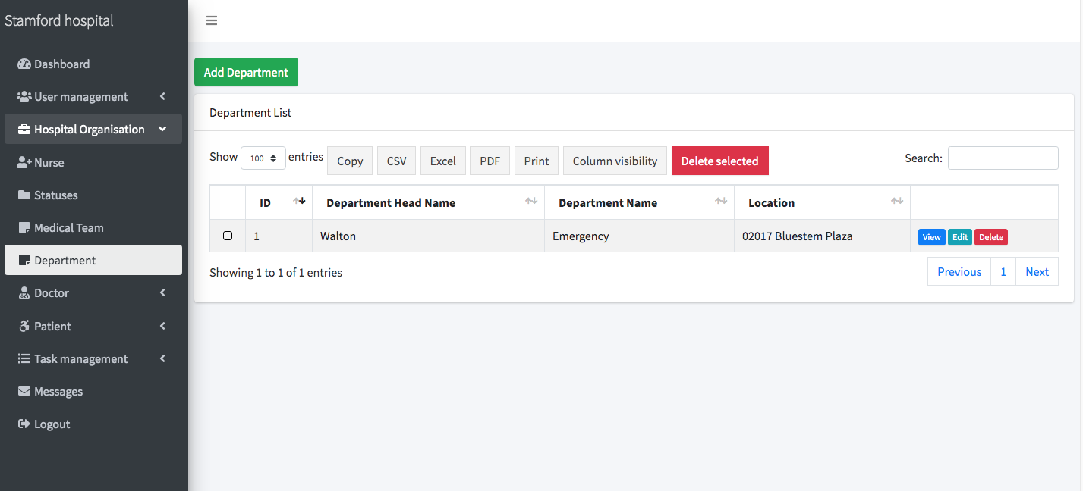
DEPARTEMENT

Slide 7

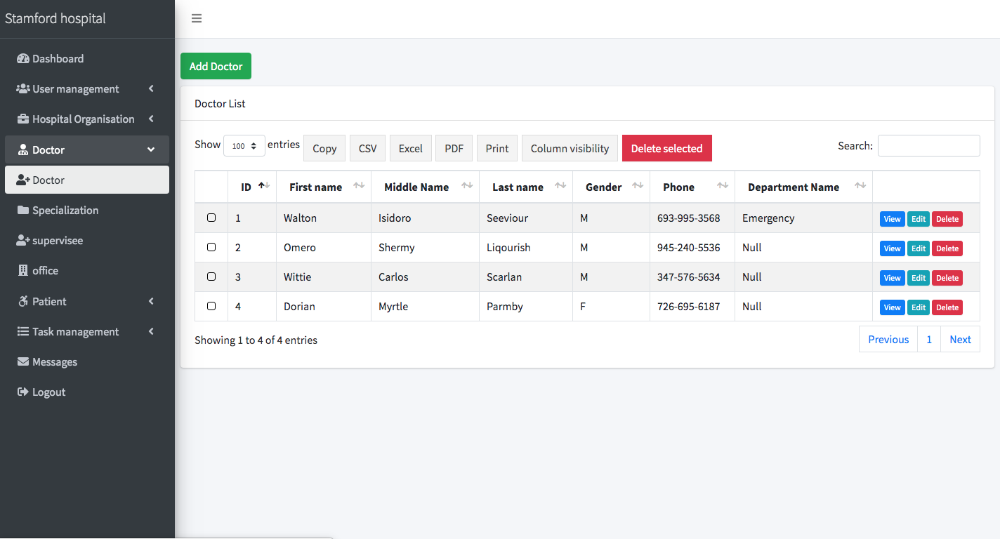

DOCTOR

Slide 8

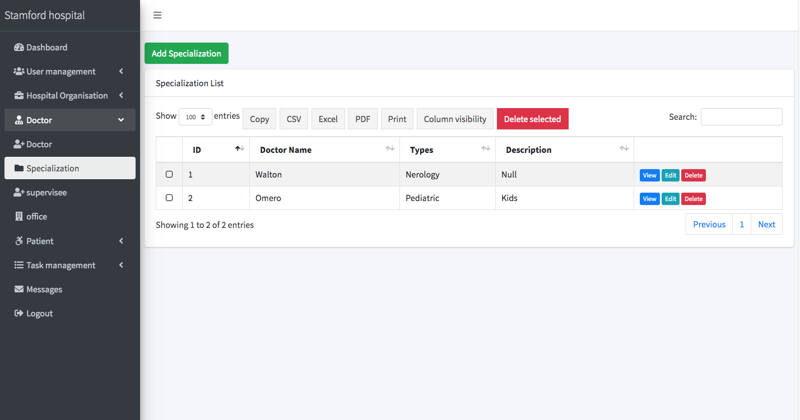

SPECIALIZATION

Slide 9

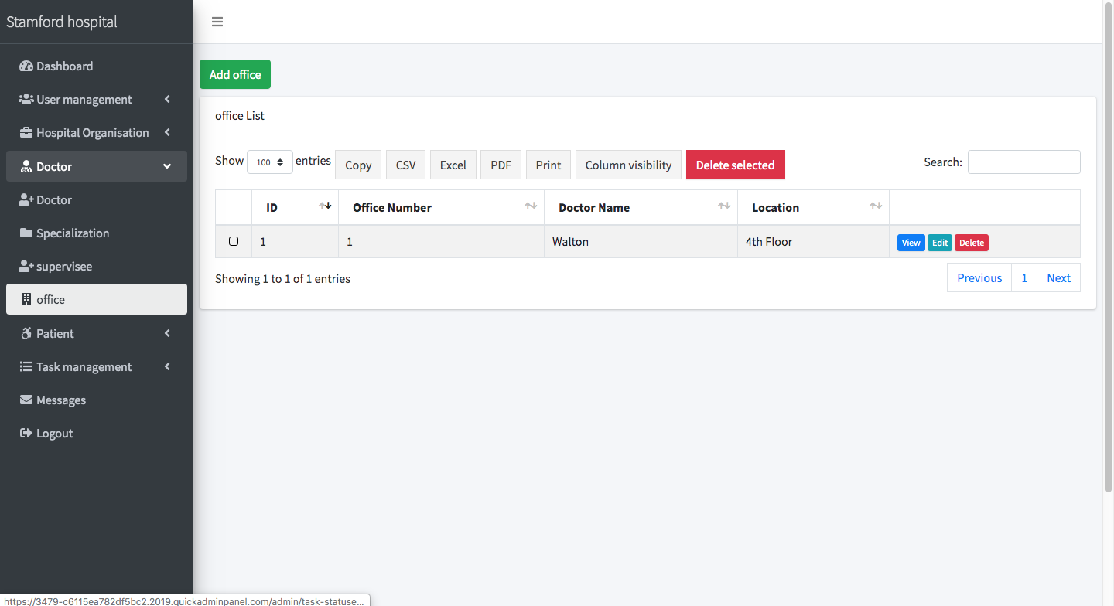
OFFICE

Slide 10
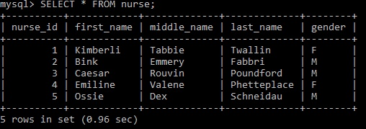
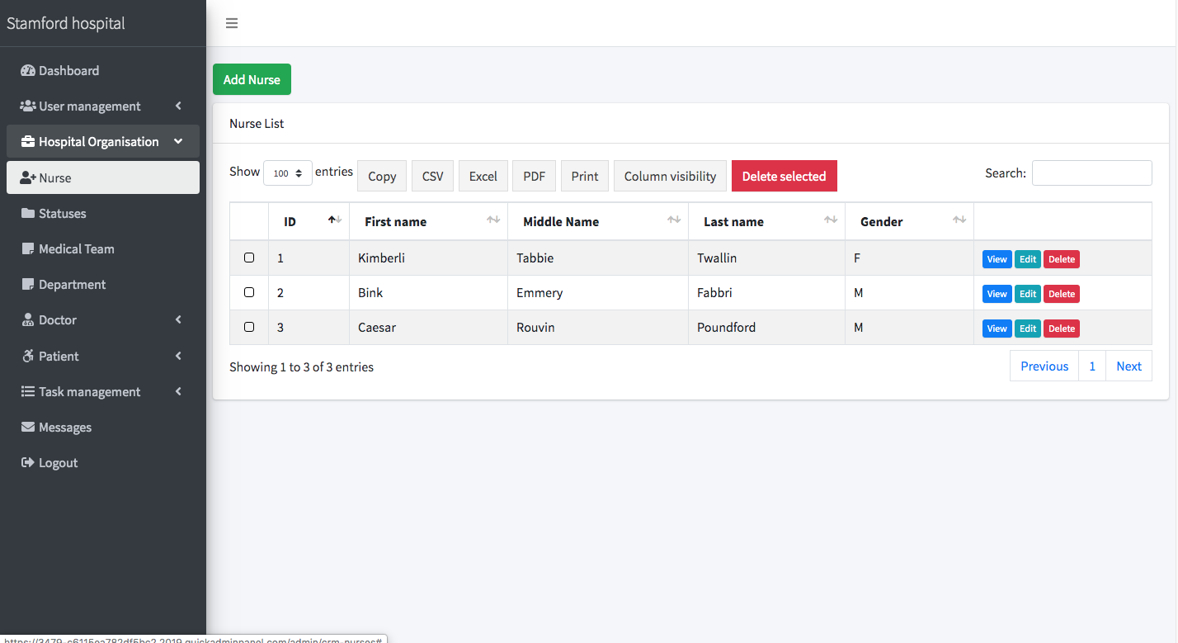

NURSE

Slide 11

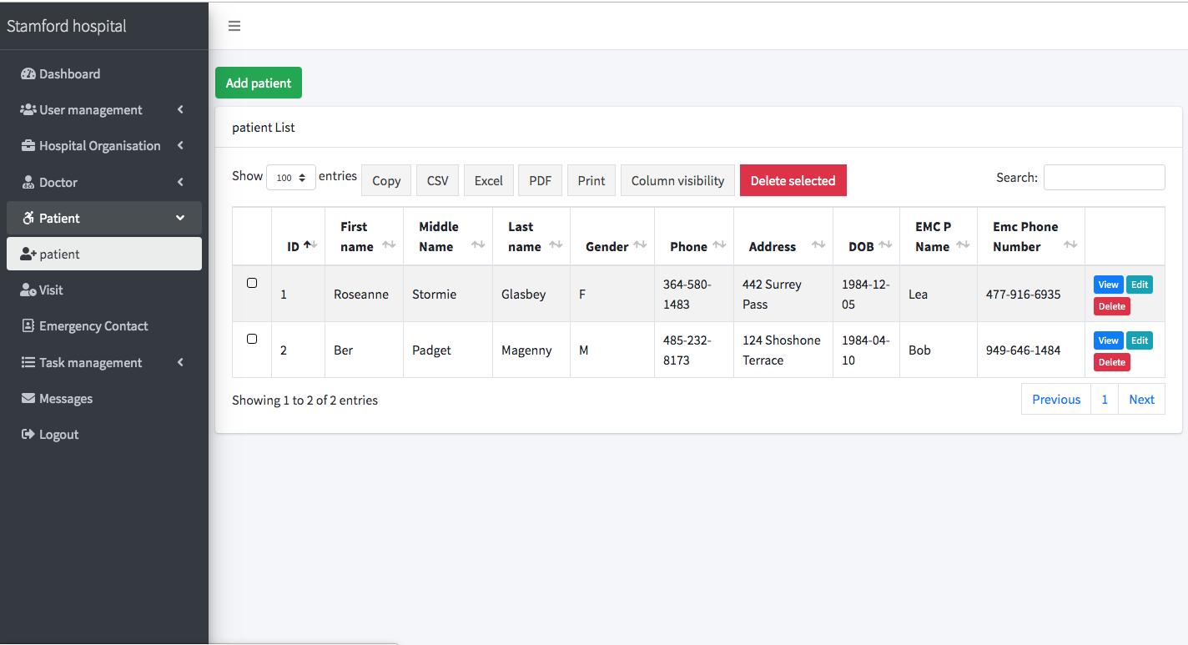
PATIENT

Slide 12

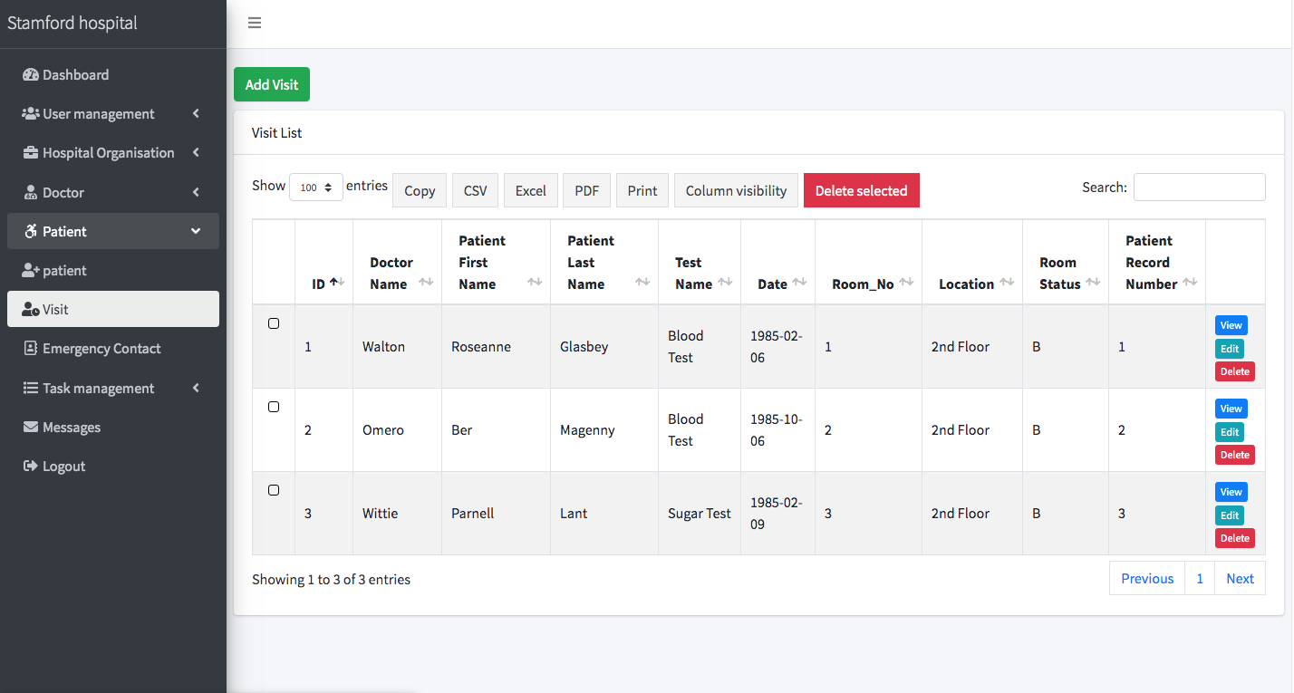
VISIT

Slide 13

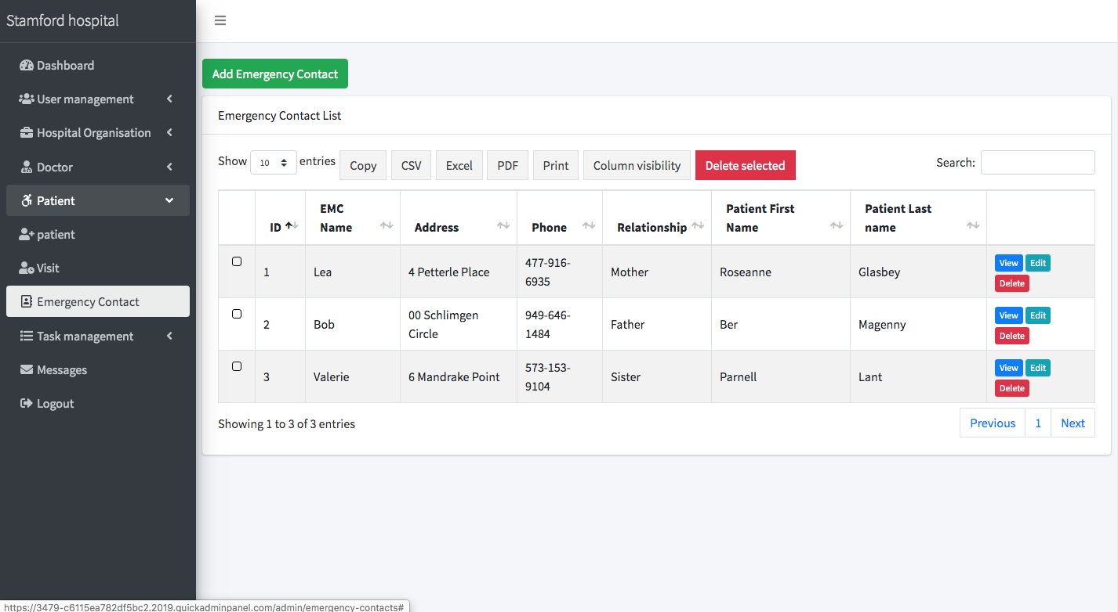
EMC

Slide 14

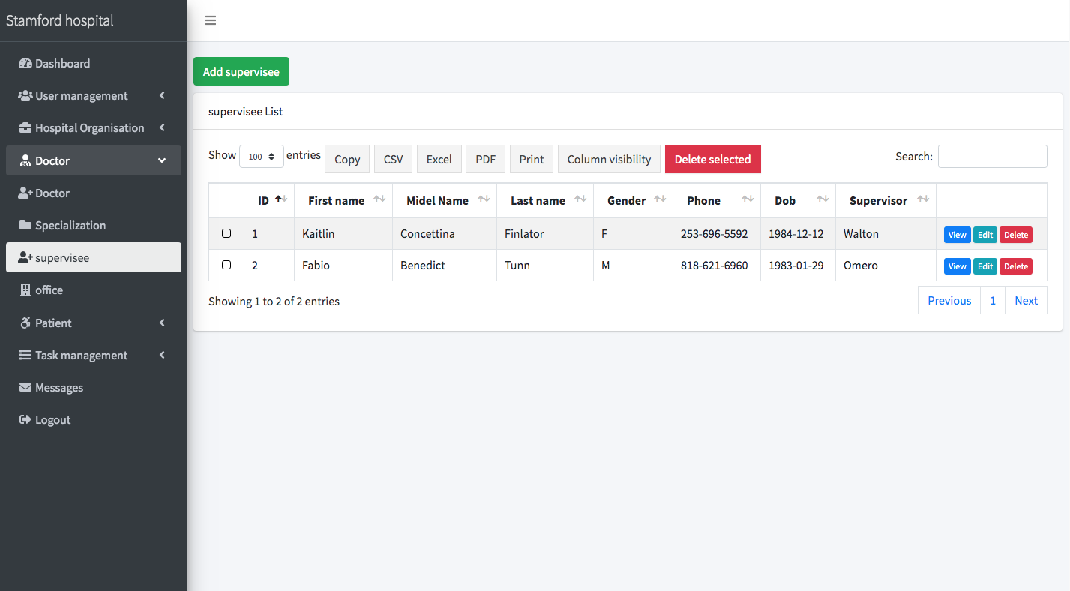
SUPERVISION

Slide 15
THANK YOU!!!

